Slide 1

Marketing Campaign
Created By: Ankita Gharate
Batch PGA-22

Slide 2

What is Marketing Campaign?
A marketing Campaign is a strategic sequence of steps and activities that promote your company’s product or service, with a specific goal.
Market campaigns are crucial for businesses to raise awareness, create interest, drive engagement, and ultimately achieve their marketing and business goals
Basically, it is an actions or events that are meant to achieve a particular result.

Slide 3
Problem Statement
iFood is experiencing a decline in customer retention rates and is struggling to maintain customer loyalty in a highly competitive food delivery market
This problem is of critical importance to iFood as it directly affects its market share, profitability, and long-term sustainability in a competitive industry.
They have to address this issue promptly to maintain iFood's leadership in the online food delivery market

Slide 4
Impact from the problem
Addressing this problem and achieving the campaign's goals will have a direct impact on iFood's profitability and market position.
Improved customer retention will result in increased revenue and long-term sustainability.

Slide 5
Objectives
The main objective is to train a predictive model which allows the company to maximize the profit of the next marketing campaign.
Moreover, than maximizing the profit of campaign, we are interested in understanding to study the characteristic features of those customers who are willing to buy or not.
The model we are building is classification problem whereas target or dependent variable is binary.

Slide 6
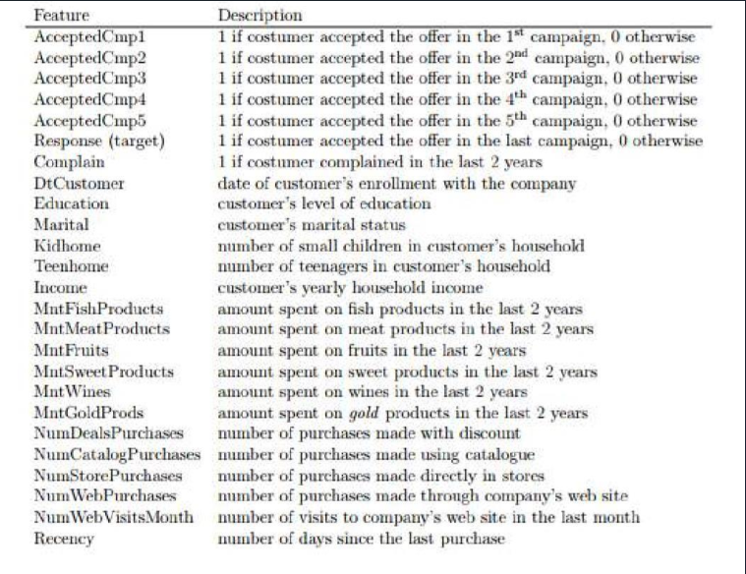
Understanding the Variables

Slide 7
Steps for Model Building
Data Collection
EDA
Feature Engineering
Defining the Problem
Model Optimization
Model Evaluation
Model Building
Train-Test Split

Slide 8
EDA (Exploratory Data Analysis)
Understanding variables
Visualization of Data
Importing Data
Cleaning Data

Slide 9
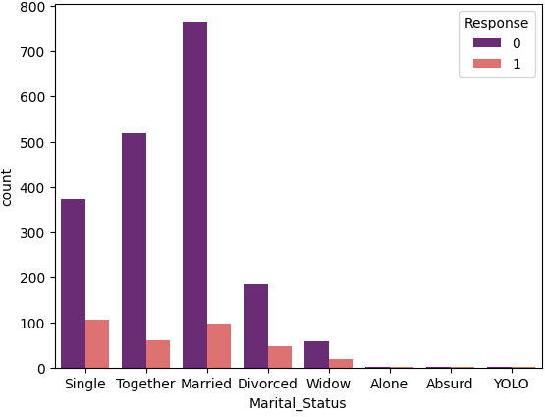
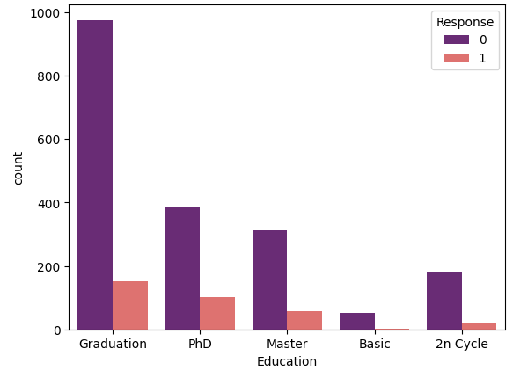
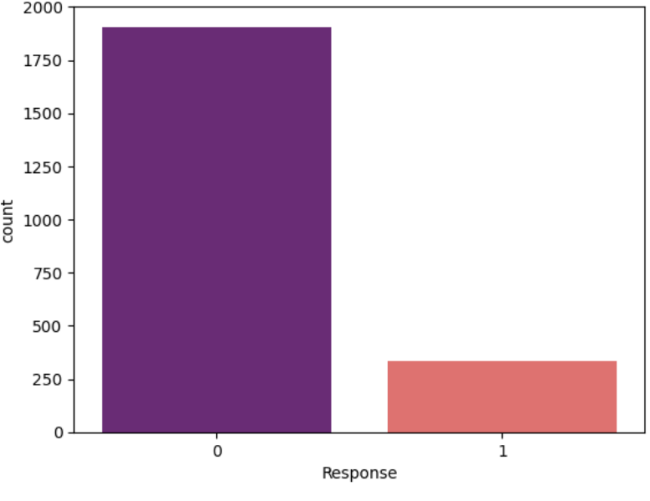
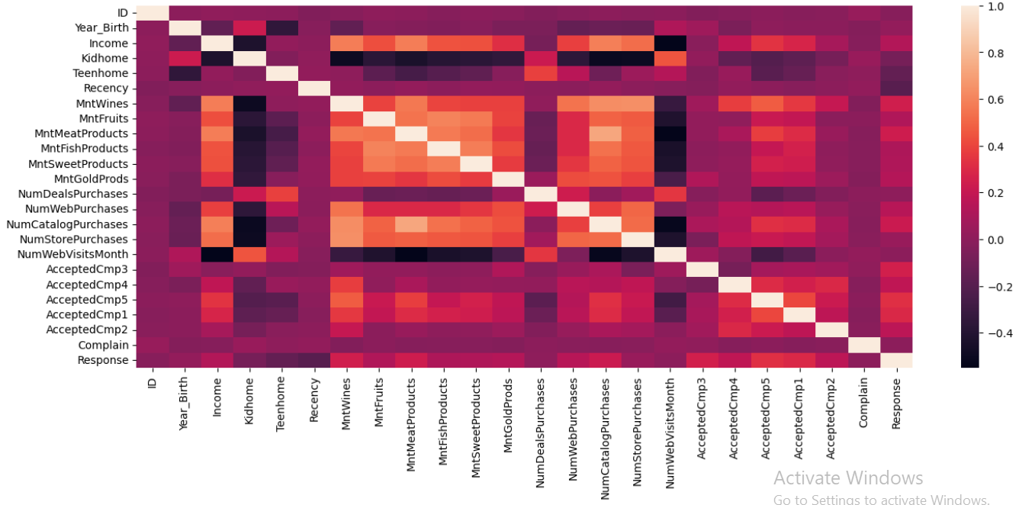
Analyzing Relationship Between Variables

Slide 10
Feature Engineering Techniques Used
Note: EDA + Feature Engineering Defines Pre-processing of model.
Encoding to convert categorical to numeric.
Feature Selection
Feature Scaling
Balancing Target Variable

Slide 11
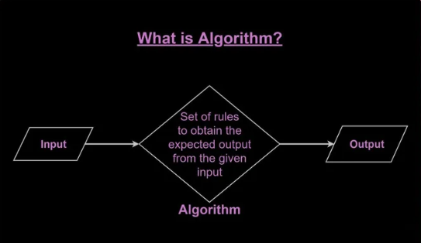
Model Building
Defining x and y
Splitting the data
Trained the algorithm on training data
Prediction is done on testing data

Slide 12
Model Evaluation
Precision
ROC
TPR
FPR
Recall
AUC
Confusion matrix
Specificity
Sensitivity
Accuracy

Slide 13

Model Optimization
If accuracy is not good we will tunned our model by having different parameters called as HYPERPARAMETER TUNNING.
This can done by GridSearchCV or RandomSearchCV.
This gives us best parameters for particular algorithm.

Slide 14
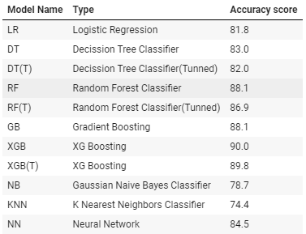
Conclusion
Accuracy scores for each of the models on the train/test data split.
As we can see, the XG Boosting and Random Forest models i.e. ensemble methods generally performed the best.

Slide 15
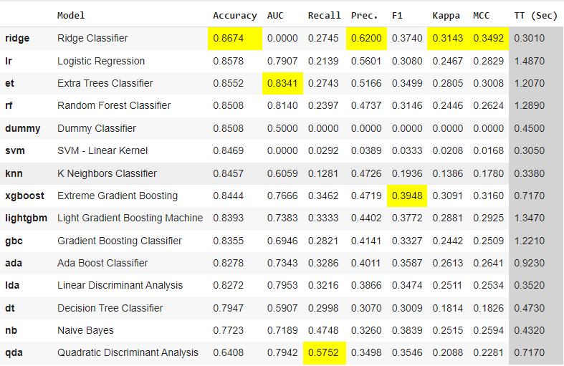
Auto ML
We can do all this process by applying Auto ML libraries such as PYCARET.
This Pycaret includes steps like auto EDA, auto FE, and implement all the ml algorithms automatically.
This gives accuracy percentage of all model as mentioned.

Slide 16
Thank You

